Slide 1
Food Concepts Training Report
Comprehensive Training Analytics
Generated: October 30, 2025

Slide 2
Executive Summary
Report Year: 2025
📊 Total Trainings: 1090
👥 Total Staff (All): 8423
✅ Active Staff: 7293
📚 Staff Trained (Active): 841
🏪 Stores Trained: 313
⏰ Pending Trainings: 7293

Slide 3
Training Frequency
Training Title | Times Held | Date Range
Food Safety | 306 | 2025-02-13 to 2025-09-30
Occupational Health And Safety | 224 | 2025-02-05 to 2025-10-23
First Aid | 201 | 2025-02-04 to 2025-10-15
Pest Control | 127 | 2025-02-18 to 2025-09-18
Fires Safety | 108 | 2025-01-30 to 2025-09-09
Water Treatment | 99 | 2025-02-19 to 2025-04-29
Food Handlers Workshop | 11 | 2025-03-21 to 2025-03-21
Frozen Pie Handling And Baking Process | 9 | 2025-06-16 to 2025-06-16
Energy Conservation | 3 | 2025-06-16 to 2025-06-16
Preventive Maintenance Workshop | 1 | 2025-06-16 to 2025-06-16
Effective Restaurant Management Workshop | 1 | 2025-06-16 to 2025-06-16

Slide 4
Stores Training Coverage
Total Stores: 612
✅ Stores Trained: 313 (51.1%)
⏳ Stores Pending: 299 (48.9%)

Slide 5
Staff Participation Analysis
Total Eligible Staff: 7293
Participated: 841 (11.5%)
Not Participated: 6452

Slide 6
Food Safety Compliance
Food Handlers / Food Safety Training Status
Required to be Tested: 7293
Already Tested: 313 (4.3%)
Never Tested: 6980
Due for Testing: 6980

Slide 7
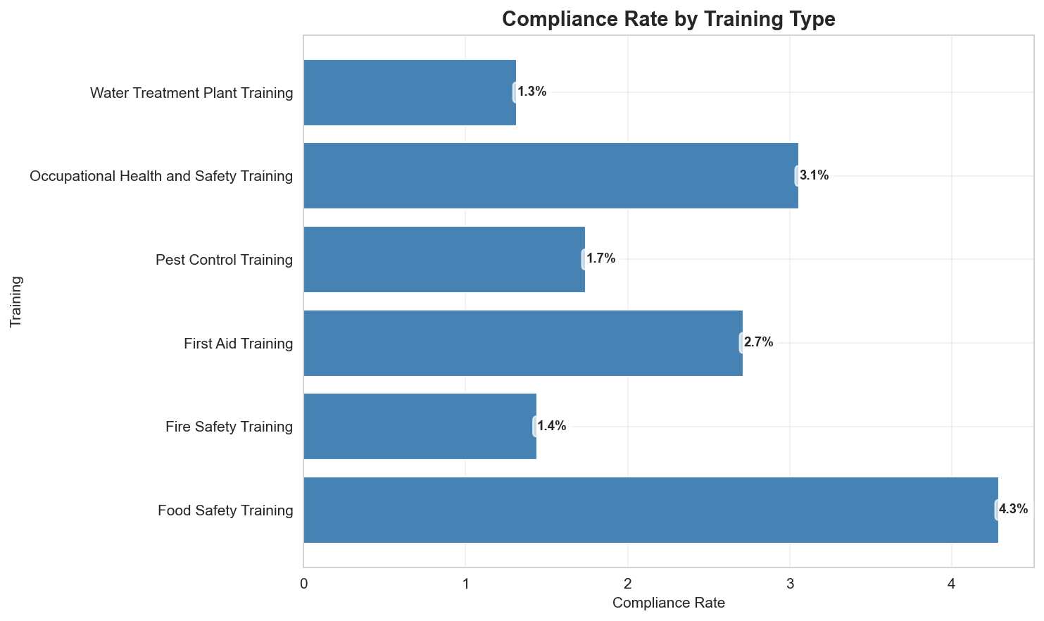
Compliance Dashboard - All Required Trainings

Slide 8
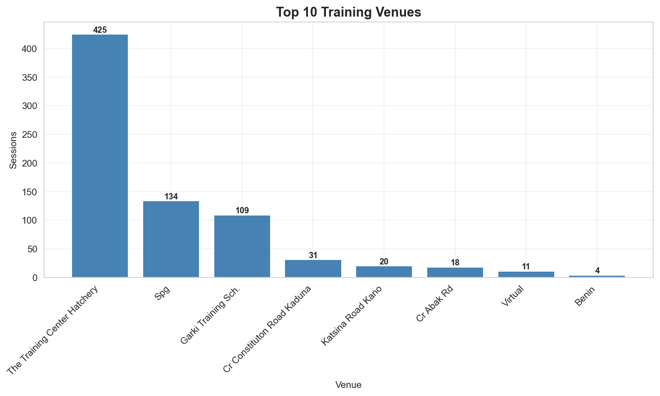
Training by Venue

Slide 9
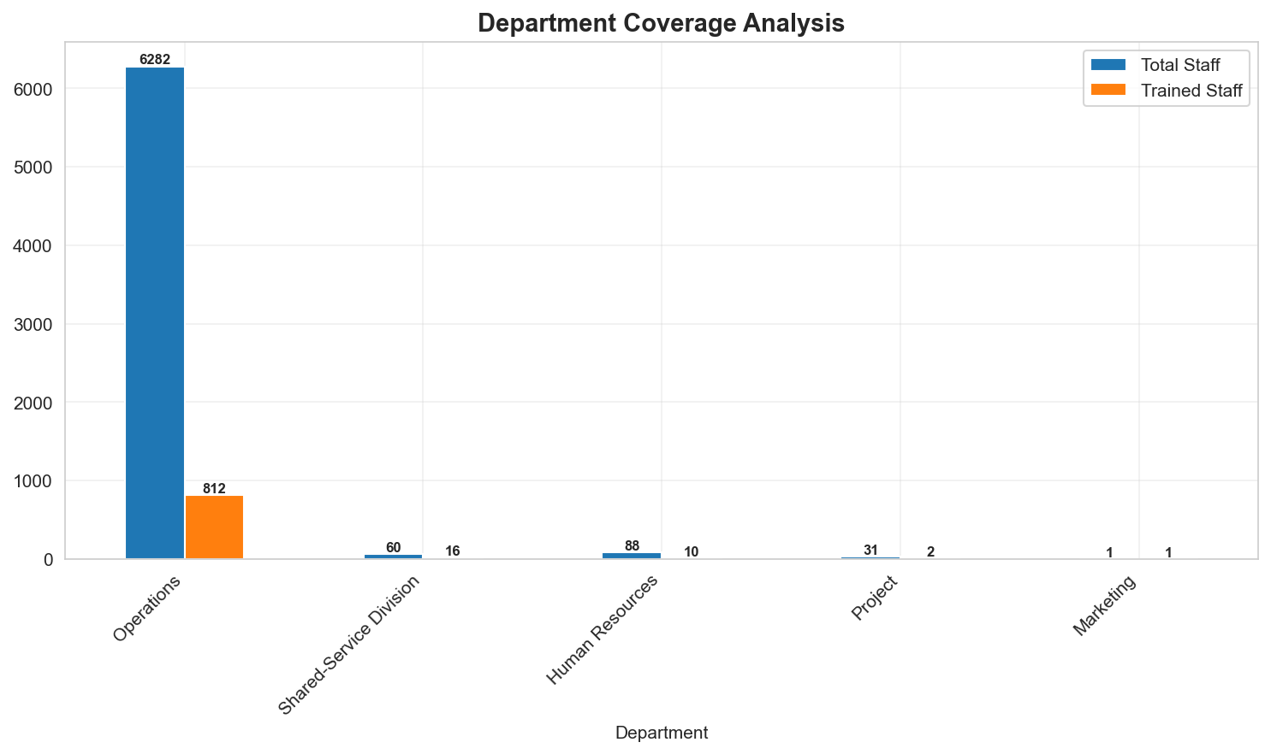
Training Coverage by Department

Slide 10
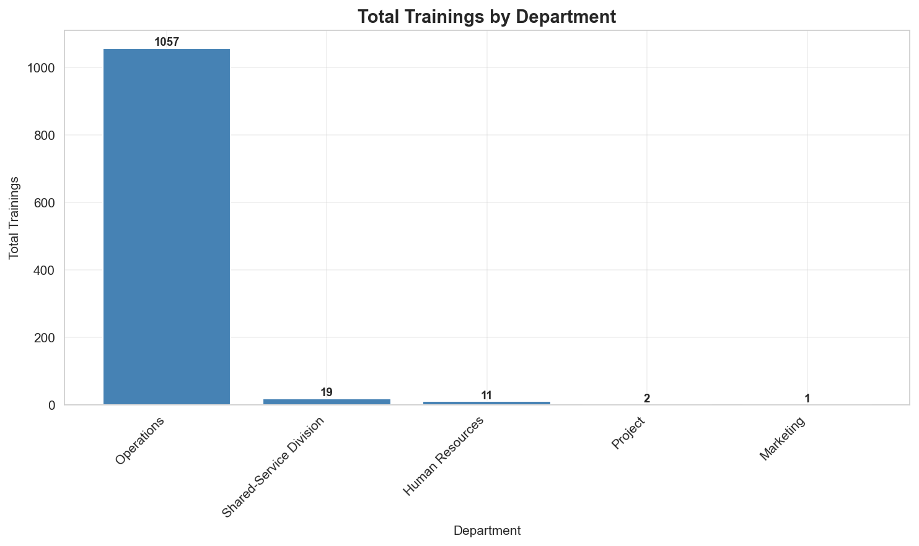
Trainings by Department

Slide 11
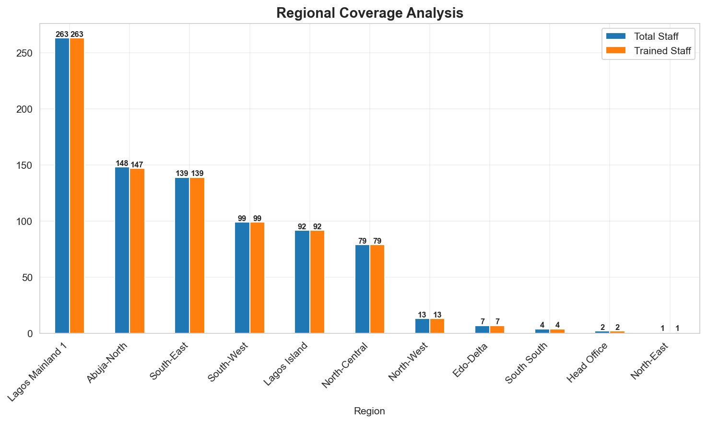
Regional Training Coverage

Slide 12
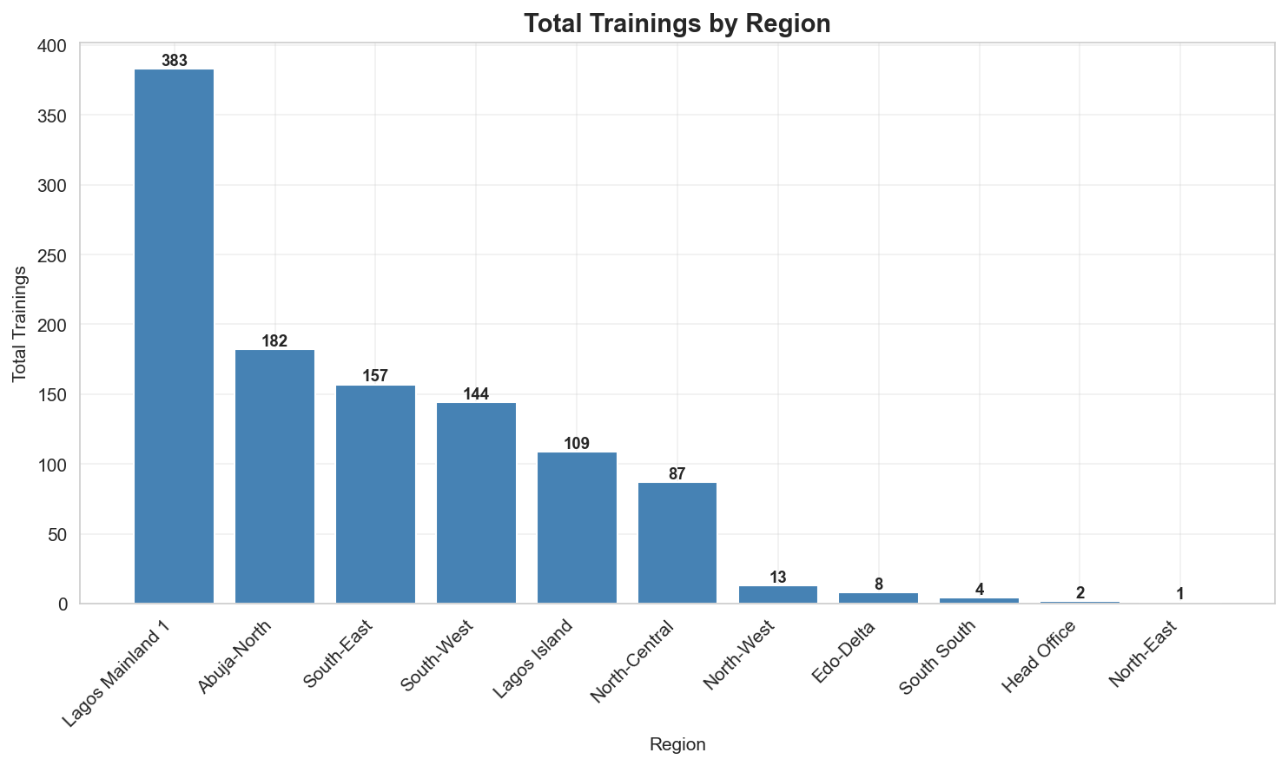
Trainings by Region

Slide 13
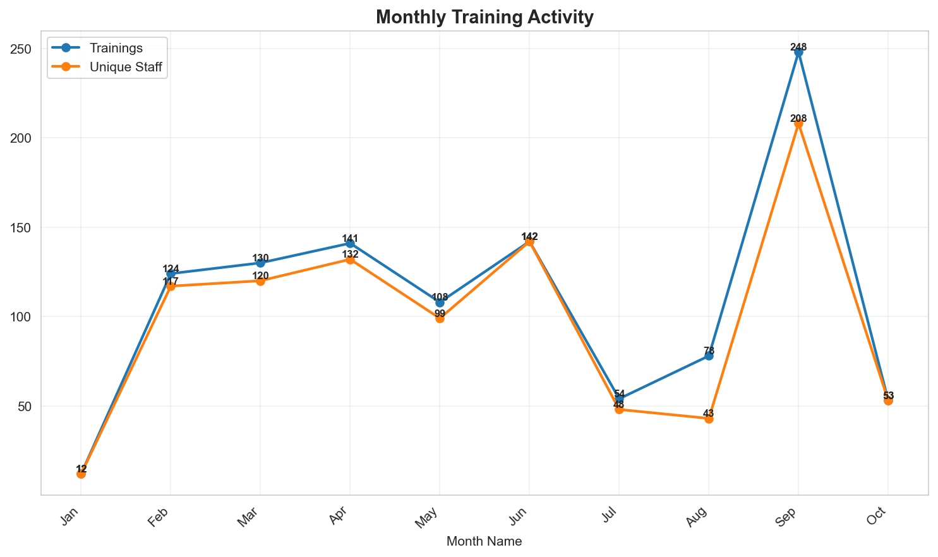
Monthly Training Trends (2025)

Slide 14
Staff Yet to be Trained
Total Staff Needing Training: 7293
These staff members are missing required trainings and are not on probation.
Top Departments:
  • Operations: 6282 staff
  • CR STORES: 384 staff
  • Human Resources: 88 staff
  • Shared-Service Division: 60 staff
  • PIE EXPRESS KIOSKS: 33 staff

